Slide 1
Exception
Day 8

Slide 2
Exception Handling in Java
The Exception Handling in Java is one of the powerful mechanism to handle the runtime errors so that the normal flow of the application can be maintained.
The core advantage of exception handling is to maintain the normal flow of the application. An exception normally disrupts the normal flow of the application; that is why we need to handle exceptions.

Slide 3
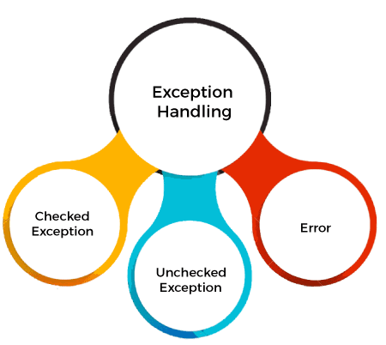
Types of Java Exceptions

Slide 4
Types
Checked Exception
The classes that directly inherit the Throwable class except RuntimeException and Error are known as checked exceptions. For example, IOException, SQLException, etc. Checked exceptions are checked at compile-time.
Unchecked Exception
The classes that inherit the RuntimeException are known as unchecked exceptions. For example, ArithmeticException, NullPointerException, ArrayIndexOutOfBoundsException, etc. Unchecked exceptions are not checked at compile-time, but they are checked at runtime.

Slide 5
Types
Checked Exception
The classes that directly inherit the Throwable class except RuntimeException and Error are known as checked exceptions. For example, IOException, SQLException, etc. Checked exceptions are checked at compile-time.
Unchecked Exception
The classes that inherit the RuntimeException are known as unchecked exceptions. For example, ArithmeticException, NullPointerException, ArrayIndexOutOfBoundsException, etc. Unchecked exceptions are not checked at compile-time, but they are checked at runtime.

Slide 6
Keywords
Keyword | Description
try | The "try" keyword is used to specify a block where we should place an exception code. It means we can't use try block alone. The try block must be followed by either catch or finally.
catch | The "catch" block is used to handle the exception. It must be preceded by try block which means we can't use catch block alone. It can be followed by finally block later.
finally | The "finally" block is used to execute the necessary code of the program. It is executed whether an exception is handled or not.
throw | The "throw" keyword is used to throw an exception.
throws | The "throws" keyword is used to declare exceptions. It specifies that there may occur an exception in the method. It doesn't throw an exception. It is always used with method signature.

